Slide 1
Current Progress of the
Phantom Development
Theme
James Joseph and Joanna Brunker

Slide 2
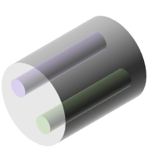

Phantom Development theme aims to develop stable PAI image quality phantoms with defined optical and acoustic properties
Standardised phantom development
Perform consortium wide tests

Slide 3
Develop stable PAI image quality phantoms with defined optical and acoustic properties
Standardised phantom development
Perform consortium wide tests
3
of 18

Slide 4
Standardized Phantom Development
Material selection
Define optical and acoustic properties
Develop and validate phantom fabrication methodology

Slide 5
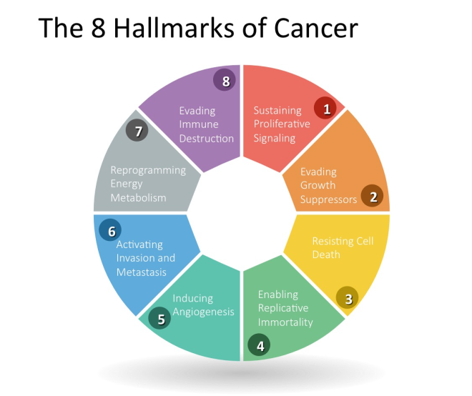








Phantom materials must fulfil certain requirements
Cost effective
Acoustic Properties
Scalable
Optical Properties
Manufacturability
Mechanically Robust
Minimal maintainence
Temporal Stability
Notes:
Safe to (prepare and) handle without specialist facilities
Base components are widely available from commercial chemical vendors, with known intra- and inter-batch variation
Ease of purchase and/or fabrication
Ease of cleaning and/or maintenance
Long-term mechanical durability and temporal stability
Potential for re-calibration (checking properties against a gold standard)
Controllable (and biologically relevant) and optical parameters
Controllable (and biologically relevant) acoustic properties
Low propensity for photobleaching

Slide 6
Two materials were initially identified as suitable phantom candidates
Material | Advantages | Disadvantages
Material | Advantages | Disadvantages
Polyvinyl chloride plastisol (PVCP) Bohndiek et al. 2013 Fonseca et al. 2015 Vogt et al. 2016 | Tissue-like acoustic properties Largely optically transparent Large Grüneisen parameter Solidity for suspending scatterers or absorbers Insoluble in water Tunable acoustic properties: hardener/softener Stable during storage, up to 3 months Can be used and re-used for imaging Tunable optical and acoustic properties
Material | Advantages | Disadvantages
Polyvinyl chloride plastisol (PVCP) Bohndiek et al. 2013 Fonseca et al. 2015 Vogt et al. 2016 | Tissue-like acoustic properties Largely optically transparent Large Grüneisen parameter Solidity for suspending scatterers or absorbers Insoluble in water Tunable acoustic properties: hardener/softener Stable during storage, up to 3 months Can be used and re-used for imaging Tunable optical and acoustic properties | Non trivial preparation 180°C needed for preparation might cause dye denaturation so only pigments should be used Higher acoustic attenuation than some soft tissues Lack of a widely available supply chain by reference chemical suppliers
Material | Advantages | Disadvantages
Polyvinyl chloride plastisol (PVCP) Bohndiek et al. 2013 Fonseca et al. 2015 Vogt et al. 2016 | Tissue-like acoustic properties Largely optically transparent Large Grüneisen parameter Solidity for suspending scatterers or absorbers Insoluble in water Tunable acoustic properties: hardener/softener Stable during storage, up to 3 months Can be used and re-used for imaging Tunable optical and acoustic properties | Non trivial preparation 180°C needed for preparation might cause dye denaturation so only pigments should be used Higher acoustic attenuation than some soft tissues Lack of a widely available supply chain by reference chemical suppliers
Gel wax Vieira et al. 2013 Cabrelli et al. 2015 Maneas et al, 2018 | Acoustic and elastic properties similar to tissue Tunable acoustic and optical properties Good temporal stability Ease of use Mechanical robustness
Material | Advantages | Disadvantages
Polyvinyl chloride plastisol (PVCP) Bohndiek et al. 2013 Fonseca et al. 2015 Vogt et al. 2016 | Tissue-like acoustic properties Largely optically transparent Large Grüneisen parameter Solidity for suspending scatterers or absorbers Insoluble in water Tunable acoustic properties: hardener/softener Stable during storage, up to 3 months Can be used and re-used for imaging Tunable optical and acoustic properties | Non trivial preparation 180°C needed for preparation might cause dye denaturation so only pigments should be used Higher acoustic attenuation than some soft tissues Lack of a widely available supply chain by reference chemical suppliers
Gel wax Vieira et al. 2013 Cabrelli et al. 2015 Maneas et al, 2018 | Acoustic and elastic properties similar to tissue Tunable acoustic and optical properties Good temporal stability Ease of use Mechanical robustness | Speed of sound lower than recommendation (1440-1445 ± 2.7 m/s vs. 1540 m/s) Not extensively validated in the literature so far Temperature dependency
Bohndiek, Sarah E., et al. 2013. PLoS ONE 8 (9): e75533. https://doi.org/10.1371/journal.pone.0075533. Maneas, Efthymios, et al. 2018. Biomedical Optics Express 9 (3): 1151.
Cabrelli, Luciana C., et al. 2015. Proceedings Volume 9531, Biophotonics South America: 95310L. Vieira, Sílvio L, et al. 2013. Ultrasound in Medicine & Biology 39 (12): 2477–84.
Fonseca, Martina, et al. 2015. Proc. SPIE: 953911 Vogt, William C., et al. 2016. Journal of Biomedical Optics 21 (10): 101405.
Notes:
Available of materials
More standardised materials – CAS numbers

Slide 7
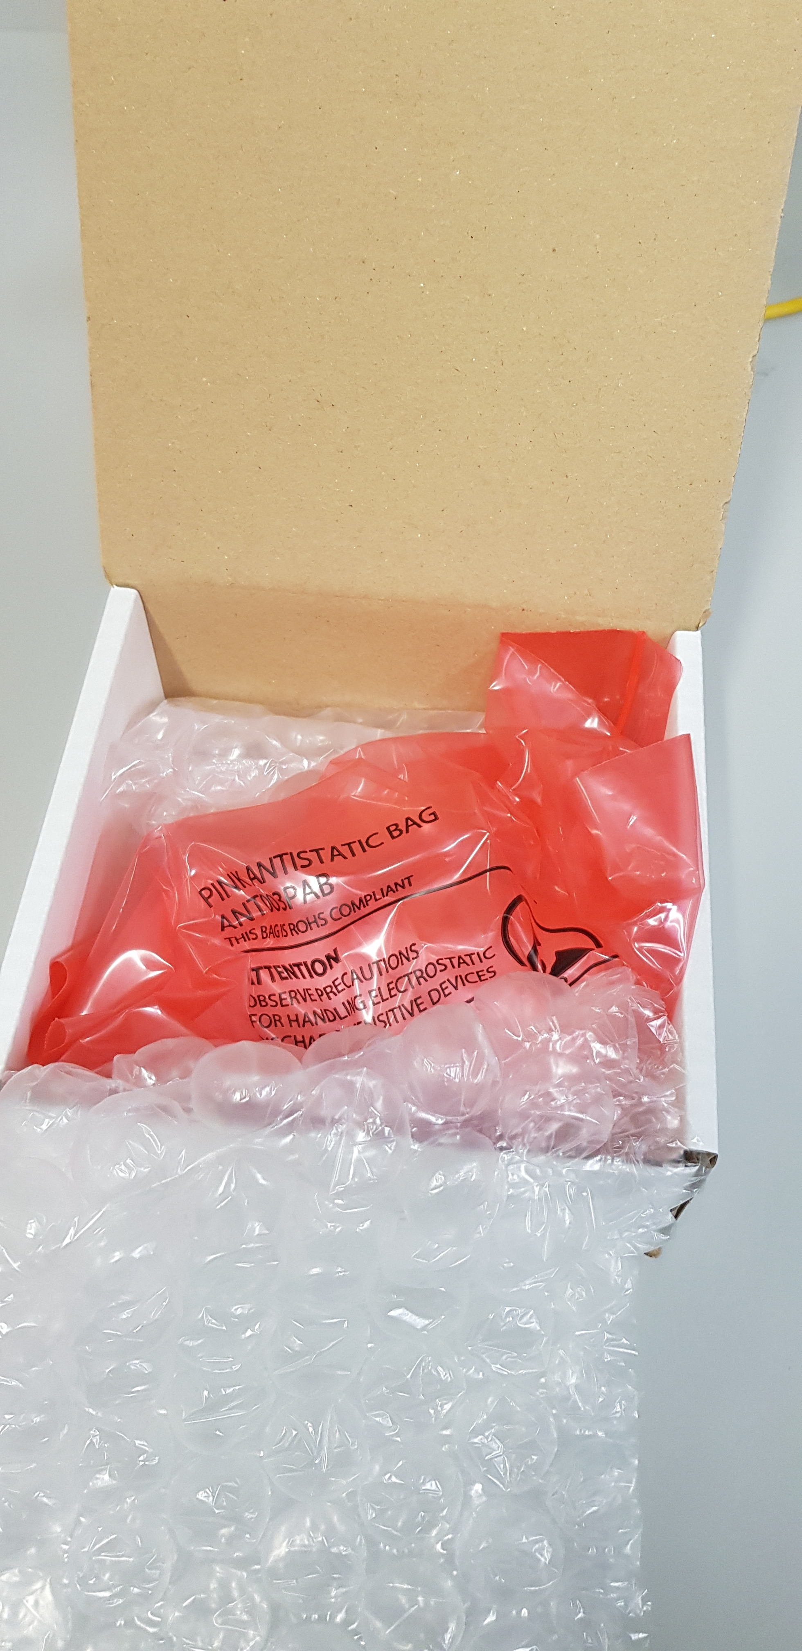
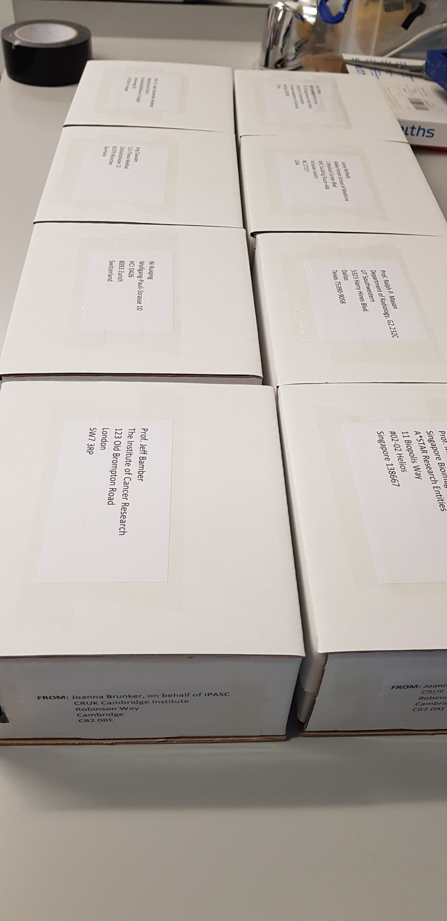
First study involved phantoms shipped to 8 sites
Jeff Bamber
Jing Claussen
Ralph Mason
Lacey McNally
Ruiqing Ni
Malini Olivo
Maximillian Waldner
Kun Wang
UK
Germany
USA
USA
Switzerland
Singapore
Germany
China

Slide 8
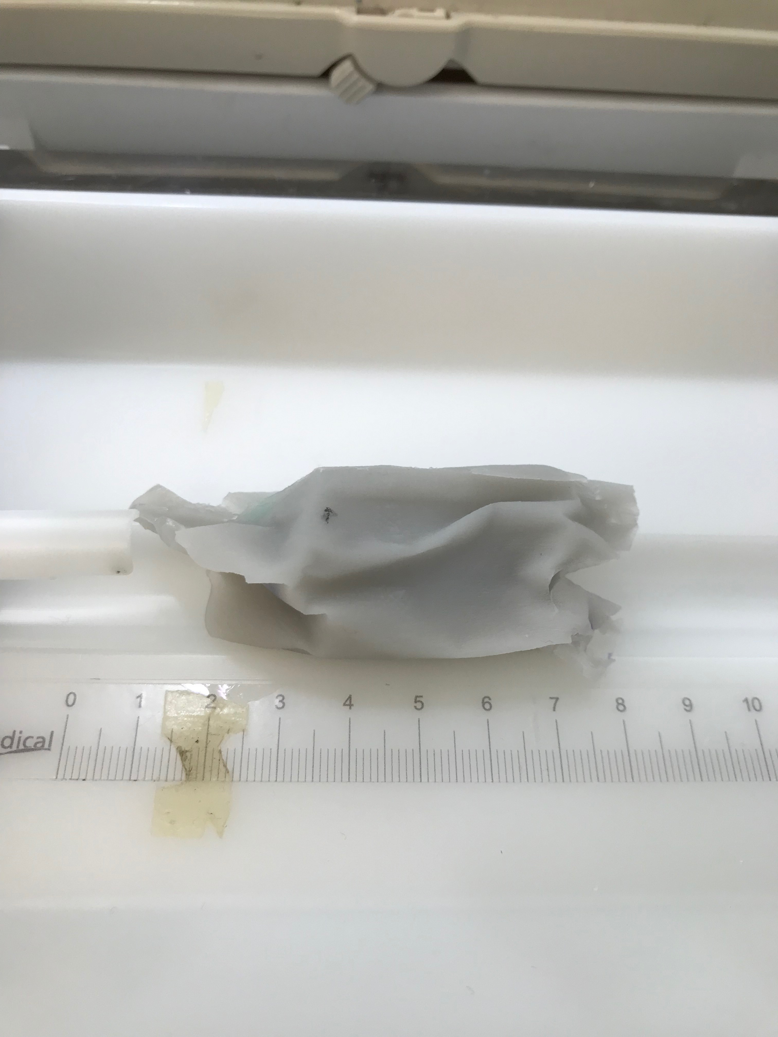
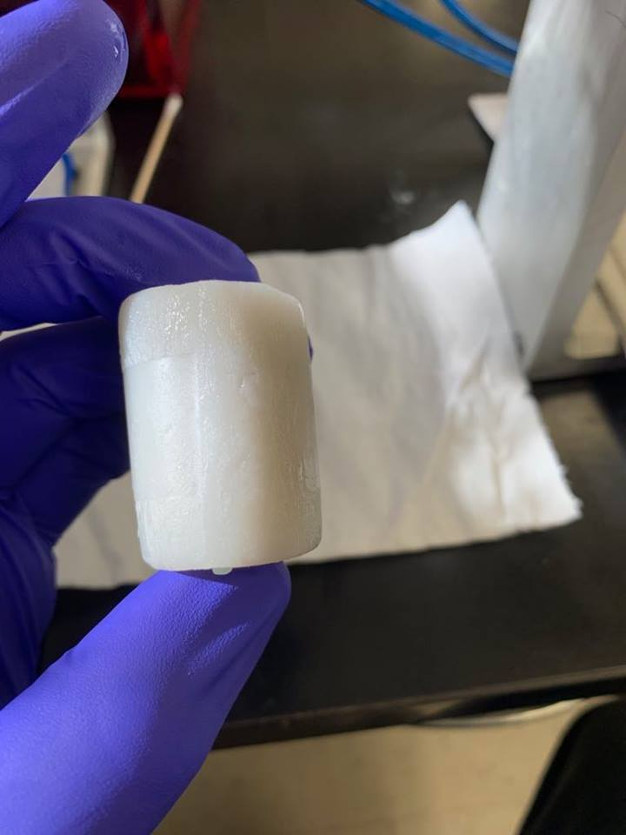
Phantoms suffered some mechanical and thermal damage

Slide 9
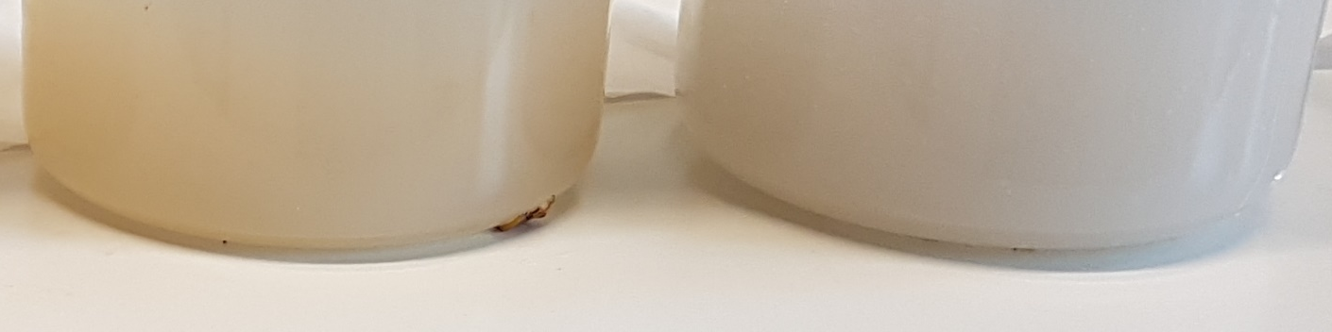
Mineral oil- Polymer composite material is chosen
 | S1 | S2 | S3 | mean | std
µa (532 nm) [mm⁻¹] | 0.006 | 0.008 | 0.006 | 0.0067 | 0.0012
µs‘ (800 nm) [mm⁻¹] | 0.24 | 0.27 | 0.26 | 0.257 | 0.0153

Slide 10
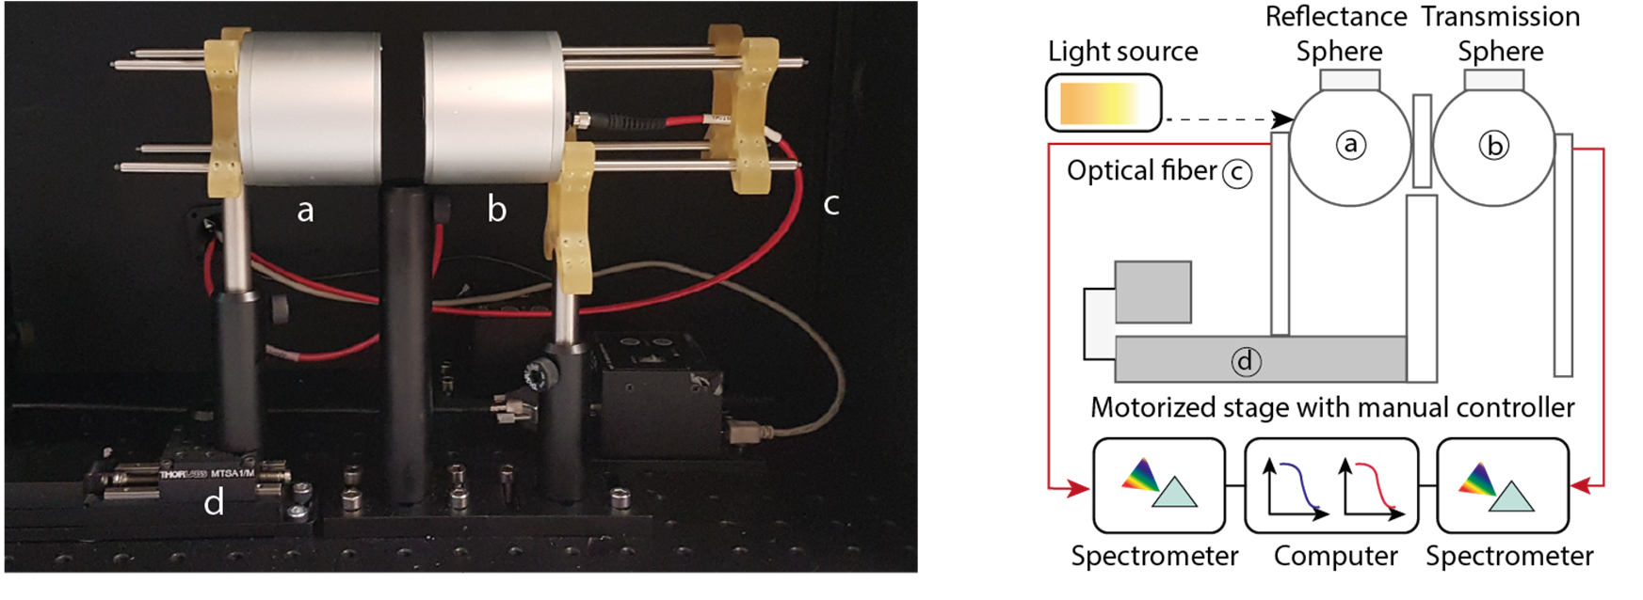
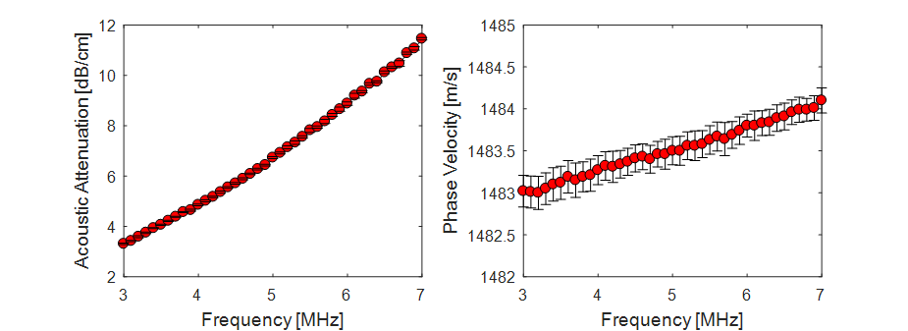
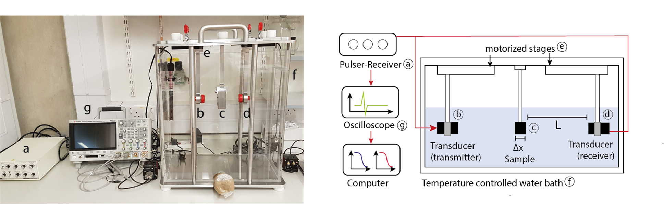
Validation of optical and acoustic properties

Slide 11
Standardised phantom development
Perform consortium wide tests

Slide 12
Multicenter fabrication of a base material
General methodology for fabricating a mineral oil-polymer composite base material was distributed to 12 participants.
Guide the respective laboratories to set up methodology to fabricate a future recommended IPASC recipe
Help the community to assess the reliability of manufacture of the base material
Protocol to fabricate phantoms with defined optical and acoustic properties will be distributed

Slide 13
Phantom Development Theme – Discussion Points
Geometries and target inclusions required
Tunable vs static optical and acoustic properties
Tuning acoustic scattering
Multi center data processing and analysis
Notes:
The background of the phantom should have the following optical properties defined at 800 nm wavelength:
Absorption coefficient (μ_{a}): 0.1 cm⁻¹
Reduced scattering coefficient (μ_{s}’): 10 cm⁻¹
The phantom inclusions/targets (except sub-resolution point/line targets) will be designed to mimic blood absorption, at least at a few specific wavelengths:
750 nm (near the deoxyhemoglobin peak at 758 nm)
800 nm (isosbestic point of hemoglobin)
850 nm (just after isosbestic point)
1064 nm (many systems use fundamental wavelength of Nd:YAG lasers)
Other biologically relevant properties include the scattering anistropy factor, g, which is included within the reduced scattering coefficient (μ_{s}’ = μ_{s}(1-g)), and the refractive index, n. However, these are considered to be less critical parameters than μ_{a} and μ_{s} for the phantom design.
Acoustic properties
The phantom acoustic properties of interest are:
Speed of sound: aim for a value close to the ultrasound standard of 1540 m/s;
Acoustic attenuation: aim for a value close to 1 dB/cm/MHz as in tissue within a frequency range of 2 - 15 MHz. The ultrasound non-linearity parameter (B/A) is ignored at this level.

Slide 14
Discussion Points - Outcome
Geometries and target inclusions required- System specific phantom geometry, target inclusions to analyze spatial resolution, Sensitivity w.r.t depth, SNR etc; feedback to SD
Final decision: Wire/mono filaments nylon? Able to sustain high heat, ~100 um
Tunable vs static optical and acoustic properties – Static properties for benchmarking phantom and tunable for application specific
Phantom needs to be tested at different temperatures
Stability at temperature, ship with a thermometer with a max/min reading? Feedback from SD
Tuning acoustic scattering – Avoid for system benchmarking
Multi center data processing and analysis – Leeds, NPL and Cambridge to get involved, get data ready for SPIE
Multi-center fabrication of base material and multi-center fabrication of image quality phantoms

Slide 15


